Slide 1
The Family Institute for Health and Human Services
After School & Enrichment Program

Slide 2
Continuing the Road Ahead
The following are the 12 updated Project C.A.R.E.S. smart goals set in place for the 2018-2019 school year. These goals will continue to help us close the achievement gap!

Slide 3
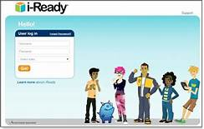

Slide 4
Smart Goal 1
Blended learning to increase students’ proficiency on the Common Core Math 1 End of the Course Exam

Slide 6
Smart Goal 2
Close the achievement gap by increasing the number of student participants gaining more than 1 year of academic growth and /or scoring a Level III or higher on the English II End of the Course Exam by 5% each school year

Slide 8
Smart Goal 3:
Increase College readiness benchmark scores for 11th and 12th grade students attending project c.a.r.e.s. for 30 days or more on the act exam

Slide 9
Smart Goal 4:
Students attending project c.a.r.e.s. at our sites for 30 days or more average daily attendance will be at or above the district’s average.

Slide 10
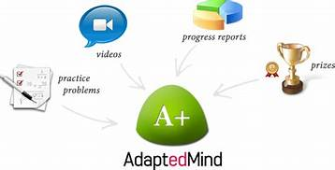

Slide 11
Smart Goal 5:
Increase the number of students that are proficient or score a level iii or above by 5% on the 6th, 7th, and 8th grade eog math exam.

Slide 13
Smart Goal 6:
Increase the number of students that are proficient or score a level iii or above by 5% on the 6th, 7th, and 8th grade eog reading exam.

Slide 15
Smart Goal 7
Increase the number of students that are proficient or score a level iii or above by 5% on the 2nd 3rd, 4th and 5th grade eog math exam.

Slide 17
Smart Goal 8
Increase the number of students that are proficient or score a level iii or above by 5% on the 2nd 3rd, 4th and 5th grade eog reading exam.

Slide 19
Smart Goal 9
Decrease the number of short term suspensions & student referrals for students attending project c.a.r.e.s. for 30 days or more below the district and/or state average

Slide 21
Smart Goal 10
50% of participants’ family members engage in one or more of the collaborative opportunities provided by project c.a.r.e.s.

Slide 22
Entrepreneurial Programs
Videography
Music Production
Arts & Craft
Embroidery
Robotics
Heat Press
Coding
Graphic Arts & Design

Slide 23
Smart goal 11
80% of enrolled students for 30 days or more will us the 21st century digital technology through the Arts to create and develop project based learning activities and projects

Slide 24
Smart Goal 12
program participants attending 30 days of more will be exposed to and trained in STEM (science Technology engineering math) topics that are aligned to their interest. Including by not limited to 1) media technology with script writing, filming and broadcasting 2) music production and recording 3) screen printing and creative design 4) coding

Slide 26
The Family Institute for Health and Human Services
After School & Enrichment Program
www.Projectcares.com

